Slide 1

Breast Cancer Healthcare & Tracking System

Slide 2

ABSTRACT
THE BREAST CANCER DATABASE IS A MEDICAL RECORD SYSTEM THAT WILL HELP TO STORE AND MANAGE PATIENT INFORMATION, INCLUDING DIAGNOSIS, TREATMENT HISTORY, AND DOCTOR ASSIGNMENTS. IT ENABLES HEALTHCARE PROVIDERS TO TRACK PATIENTS, RECORD MEDICAL HISTORIES, AND MONITOR TREATMENTS. THERE ARE MULTIPLE MODULES THAT ALLOW FOR EFFICIENT MANAGEMENT OF PATIENT RECORDS, HOSPITAL DATA, AND DOCTOR SPECIALIZATIONS, ENSURING ACCURATE AND SECURE STORAGE OF MEDICAL INFORMATION.

Slide 3
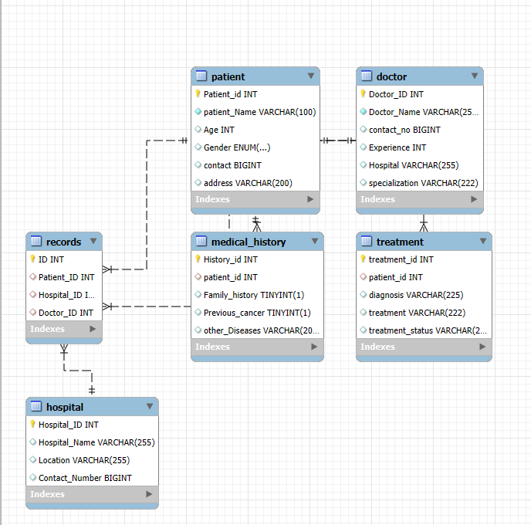
ER DIAGRAM

Slide 4
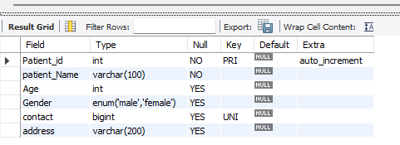
STRUCTURE OF TABLE
PATIENT TABLE
This Table contain patient details such as ID,NAME,AGE,GENDER,
CONTACT,ADDRESS
Syntax :
DESC Patient;

Slide 5
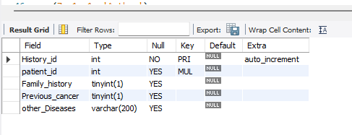
Medical history Table
This Table contain Medical history details such as
History id , Patient id,
Family history,
Previous cancer,
Other diseases
Syntax :
DESC Medical_History;

Slide 6
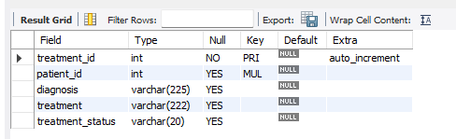
Treatment Table
This Table contain Treatment details such as
Treatment id , Patient id,
diagnosis, Treatment,
Treatment status
Syntax :
DESC Treatment;

Slide 7
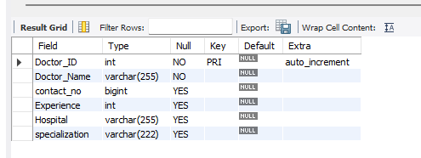
Doctor Table
This Table contain Doctor details such as
Doctor id , Doctor Name,
Experience, Hospital,
Specialization
Syntax :
DESC Doctor;

Slide 8
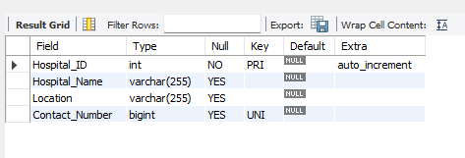
Hospital Table
This Table contain Hospital details such as
Hospital id,
Hospital Name,
Location, Contact number
Syntax :
DESC Hospital;

Slide 9
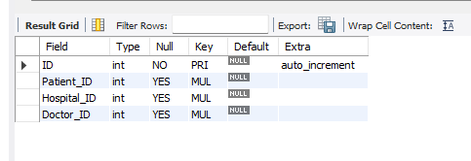
Records Table
This Table contain records details such as
Patient id,
Hospital id,
Doctor id,
Syntax :
DESC Records;

Slide 10
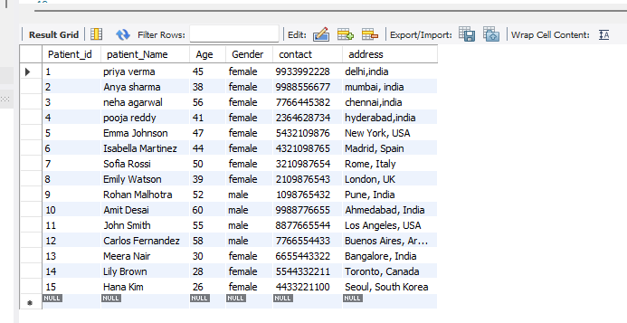
CONTENTS OF TABLE
PATIENT TABLE

Slide 11
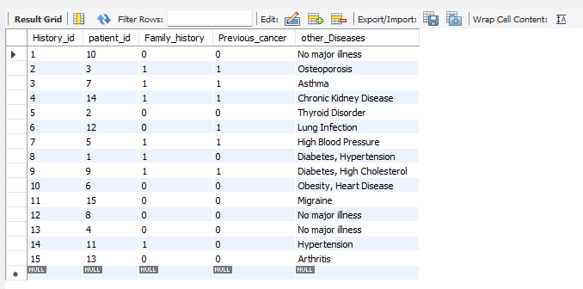
Medical history Table

Slide 12
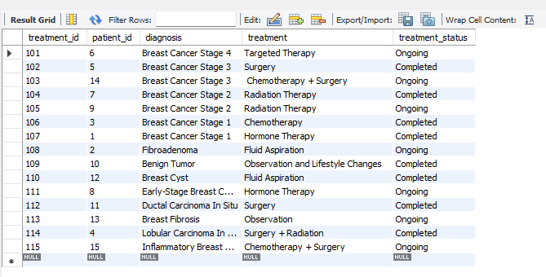
Treatment Table

Slide 13
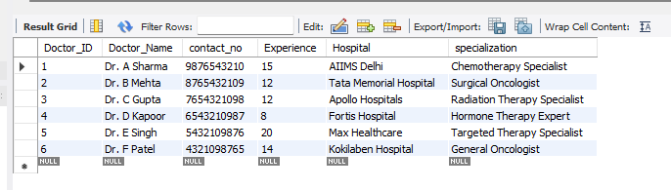
Doctor Table

Slide 14
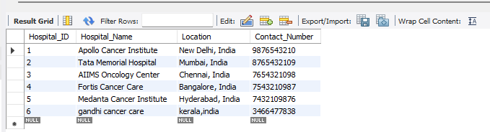
Hospital Table

Slide 15
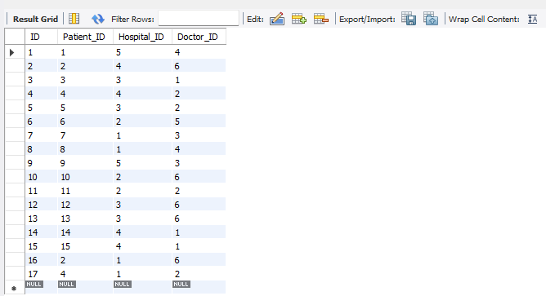
Records Tables

Slide 16
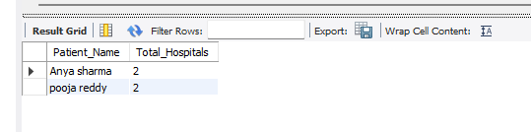
JOINS
Question: Retrieve the names of patients who have visited more than one hospital
SYNTAX:
SELECT pPatient_Name, COUNT(DISTINCT rHospital_ID) AS Total_Hospitals
FROM Patient p
JOIN Records r ON pPatient_ID = rPatient_ID
GROUP BY pPatient_ID
HAVING COUNT(DISTINCT rHospital_ID) > 1;

Slide 17
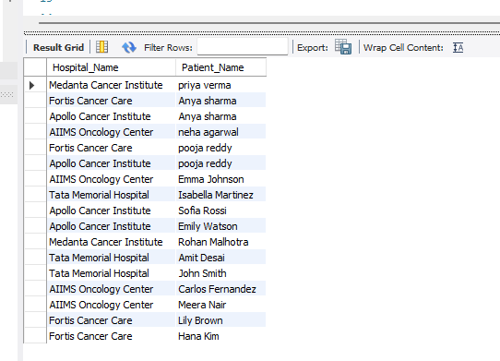
Question: Display all hospitals and the patients associated with them
SYNTAX :
SELECT hHospital_Name, pPatient_Name
FROM Hospital h
RIGHT JOIN Records r ON hHospital_ID = rHospital_ID
RIGHT JOIN Patient p ON rPatient_ID = pPatient_ID;

Slide 18
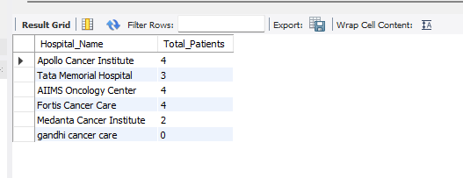
Question: Retrieve the number of patients associated with each hospital
SYNTAX :
SELECT hHospital_Name, COUNT(rPatient_ID) AS Total_Patients
FROM Hospital h
LEFT JOIN Records r ON hHospital_ID = rHospital_ID
GROUP BY hHospital_Name;

Slide 19
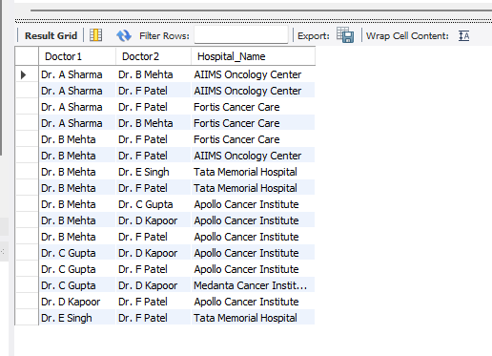
Question: find pairs of doctors working in the same hospital
SYNTAX:
SELECT DISTINCT LEAST(d1.Doctor_Name, d2.Doctor_Name) AS Doctor1, GREATEST(d1.Doctor_Name, d2.Doctor_Name) AS Doctor2, h.Hospital_NameFROM Records r1JOIN Records r2 ON r1.Hospital_ID = r2.Hospital_ID AND r1.Doctor_ID < r2.Doctor_IDJOIN Doctor d1 ON r1.Doctor_ID = d1.Doctor_ID -- Ensure correct referenceJOIN Doctor d2 ON r2.Doctor_ID = d2.Doctor_ID -- Ensure correct referenceJOIN Hospital h ON r1.Hospital_ID = h.Hospital_ID;

Slide 20
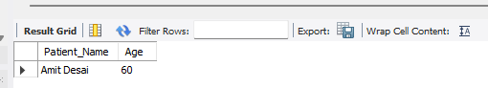
Subqueries
Question: Find the oldest patient in the database
SYNTAX :
SELECT Patient_Name, Age FROM Patient
WHERE Age = (SELECT MAX(Age) FROM Patient);

Slide 21
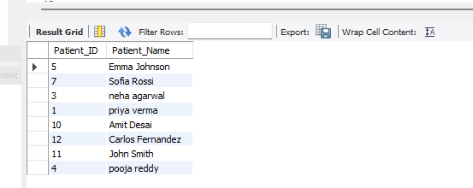
Question: Retrieve all patients who have completed treatment
SYNTAX :
SELECT Patient_ID, Patient_Name
FROM Patient
WHERE Patient_ID IN (SELECT Patient_ID FROM Treatment WHERE treatment_status = 'Completed');

Slide 22
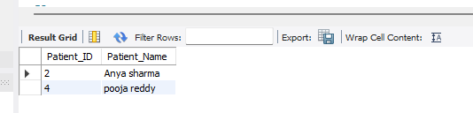
Question: Find patients who have multiple records in the records table
SYNTAX :
SELECT Patient_ID, Patient_Name
FROM Patient p
WHERE EXISTS (SELECT 1 FROM Records r WHERE pPatient_ID = rPatient_ID GROUP BY rPatient_ID HAVING COUNT(*) > 1);

Slide 23
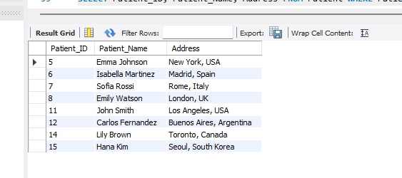
Question: Find Patients Not from India
SYNTAX:
SELECT Patient_ID, Patient_Name, Address FROM Patient WHERE Patient_ID IN ( SELECT Patient_ID FROM Patient WHERE Address NOT LIKE '%India%');

Slide 24
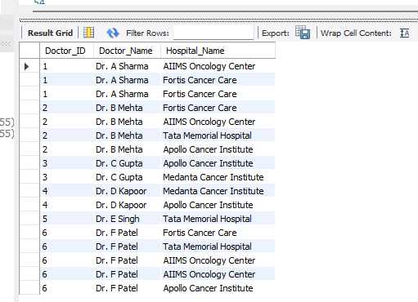
VIEW
CREATE VIEW AS DOCTOR HOSPITAL.
SYNTAX:
CREATE VIEW DoctorHospital AS
SELECT d.Doctor_ID, d.Doctor_Name, h.Hospital_Name
FROM Doctor d, Records r, Hospital h
WHERE d.Doctor_ID = r.Doctor_ID AND r.Hospital_ID = h.Hospital_ID;

Slide 25
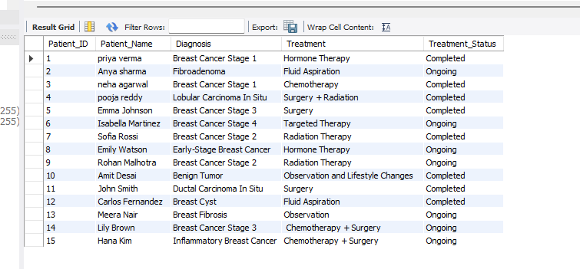
CREATE VIEW AS PATIENT TREATMENT DETAILS.
SYNTAX:
CREATE VIEW PatientTreatmentDetails AS
SELECT p.Patient_ID, p.Patient_Name, t.Diagnosis, t.Treatment, t.Treatment_Status
FROM Patient p, Treatment t
WHERE p.Patient_ID = t.Patient_ID;

Slide 26


